Slide 1

Introduction to Photoshop
Ciara Byrne

Slide 2
Searching for Images
It is considered Illegal to use any image that holds a copyright without that owner’s permission or without purchasing a license that grants that permission
1
There are ways of searching for images which you won’t need permission to use
2
The easiest and most efficient way of doing this is using Creative Commons
3

Slide 3

Creative Commons is a non-profit organization dedicated to ensuring that more creative works are available to be shared legally
The organization has released several copyright licenses for public use, known as Creative Commons Licenses
The licenses are a simple one page document outlining which rights are waived by the content creators and which they have reserved

Slide 4
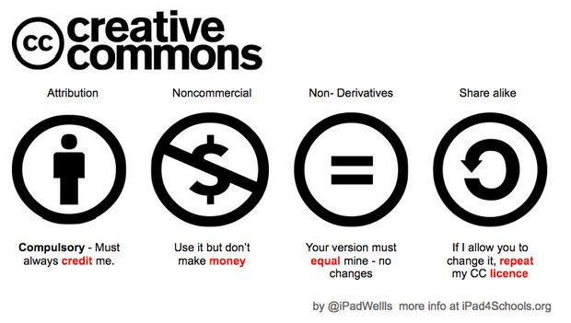
CC Licence Elements

Slide 5


Slide 6
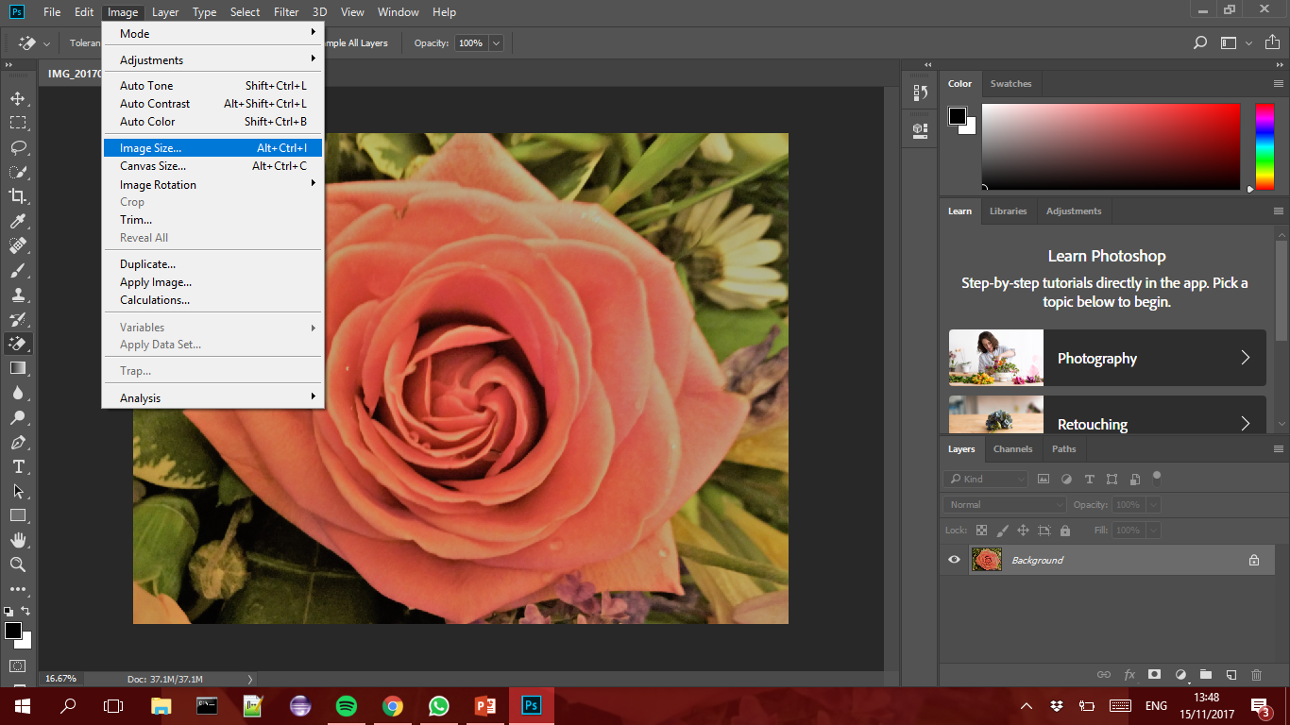
Resizing Images

Slide 7
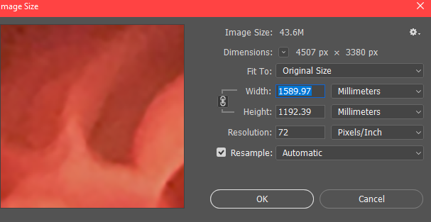
Resizing Images

Slide 8
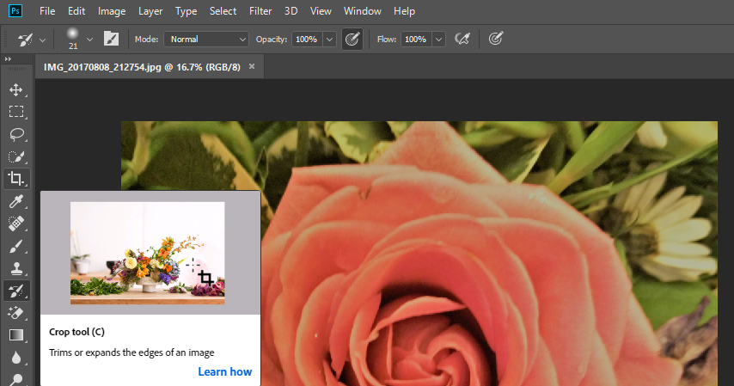
Cropping/Straightening and Rotating Images

Slide 9
Cropping/Straightening and Rotating Images
Drag any edge or corner to adjust the size and shape of the crop border.
Drag inside the crop border to position the image inside the crop border.
Drag outside a corner of the crop border to rotate or straighten.
Click the check mark in the options bar or press Enter (Windows) or Return (macOS) to complete the crop.

Slide 10
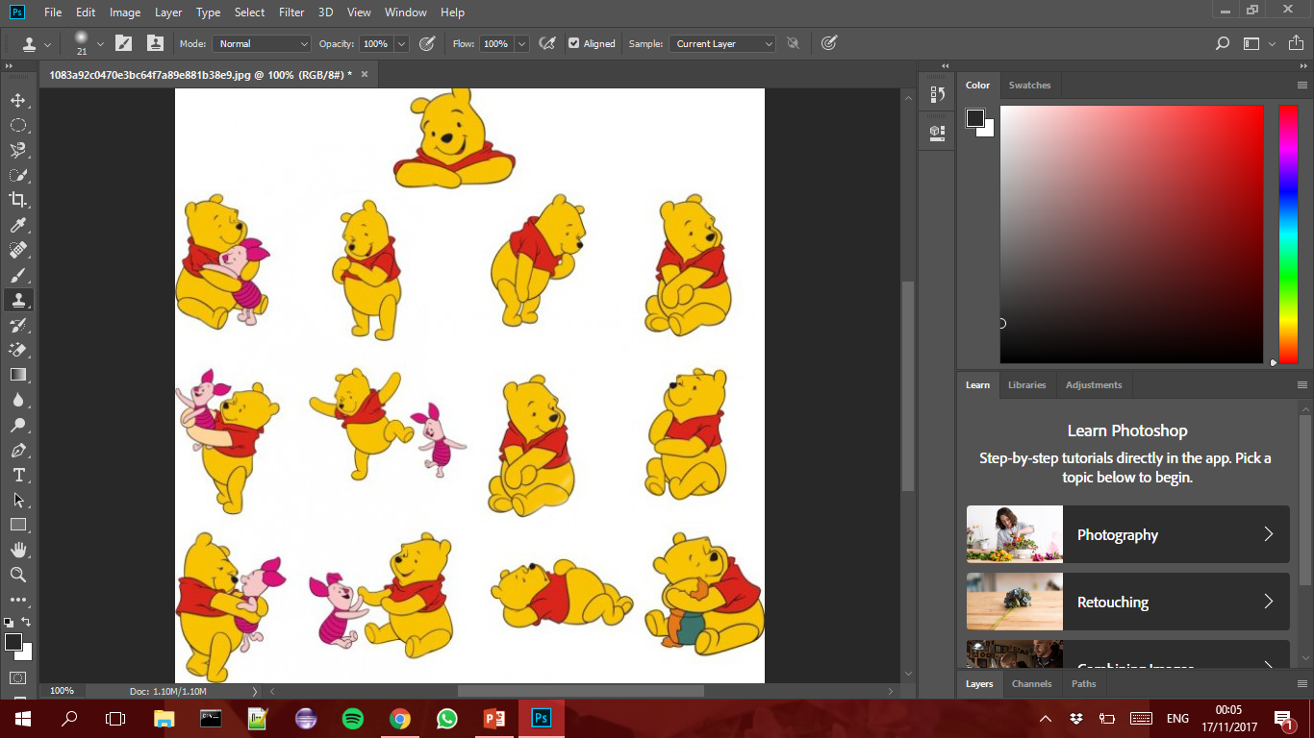
Removing Objects From Photographs
Choose a Selection Tool
Press ctrl + x
The object will not be removed and replaced with a white background

Slide 11
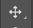
Removing an Object and Replacing it with a Cloned Part of the Image
Use the selection tool of your choice to select the element that you want to remove.
Place your cursor on the edge of the selection until the icon below your cursor appears as a rectangle and move the selected area to the part of the image you want to clone
With the Move Tool selected hold down Alt+Shift, and then drag to move the cloned area on top of the element that you’re removing.
Carefully match up the edges, release your mouse button, and then release the Alt and Shift keys.
Choose Select→Deselect.

Slide 12
Moving Objects in Images
Use the selection tool to select the object you wish to move
Select the move tool
Click the object and move to where you want to put it

Slide 13
Covering up Removed Objects by Cloning Parts of the Image
Select the Clone Stamp Tool
Hold down Alt and select the are you wish to clone
Release Alt and begin painting over the area you want to replace

Slide 14
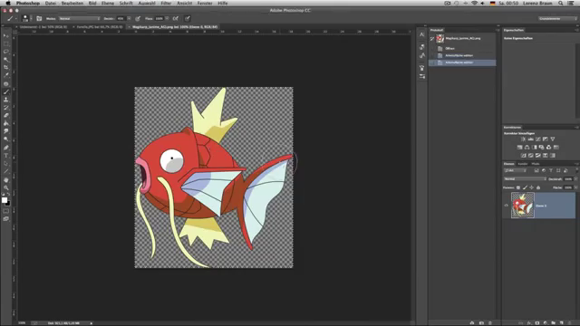

Slide 15
Useful Links
Search Creative Commons: https://search.creativecommons.org/
Creative Commons Licences: https://creativecommons.org/licenses/
How to attribute: http://creativecommons.org.au/materials/attribution.pdf
Tiny Eye Reverse Image Search: https://www.tineye.com/

